Slide 1

PROJECT PRESENTATION
Credit Card Fraud detection using Clustering
By Aritrajit Roy

Slide 2
Objective
To identify the fraud from the non-fraud cases using Clustering
Analyzing the dataset and understand it using visualizations

Slide 3
Methodology
The "Time" column has information about the time lapsed between each transaction and the first transaction it can be dropped .
The values in the column "Amount" is significantly larger than the values in the columns V(i) ;where i ranges from 1 to 28. Hence this dataset has to be balanced .
Check the shape, size, other data preprocessing , number of fraud cases in dataset, etc.
Remove Duplicates.
Data Visualization using matplotlib.pyplot, seaborn, numpy, pandas, etc.
Apply clustering algorithms like K-Means, DBSCAN, Hierarchical Clustering.

Slide 4
Inputs
Dataset Link: https://www.kaggle.com/datasets/mlg-ulb/creditcardfraud/data
The dataset contains transactions made by credit cards in September 2013 by European cardholders.
This dataset presents transactions that occurred in two days, where we have 492 frauds out of 284,807 transactions.
The dataset is highly unbalanced, the positive class (frauds) account for 0.172% of all transactions.
It contains only numerical input variables which are the result of a PCA transformation.
Unfortunately, due to confidentiality issues, the original features have not been provided .
Features V1, V2, … V28 are the principal components obtained with PCA,
The only features which have not been transformed with PCA are 'Time' and 'Amount'.
Feature 'Time' contains the seconds elapsed between each transaction and the first transaction in the dataset.
The feature 'Amount' is the transaction Amount, this feature can be used for example-dependant cost-sensitive learning.
Feature 'Class' is the response variable and it takes value 1 in case of fraud and 0 otherwise.

Slide 5
Checking the fraud cases
Percentage of fraud cases: 0.16698852262818045% ~ 0.172%
Fraud Cases: 473
Valid Transactions: 283253

Slide 6
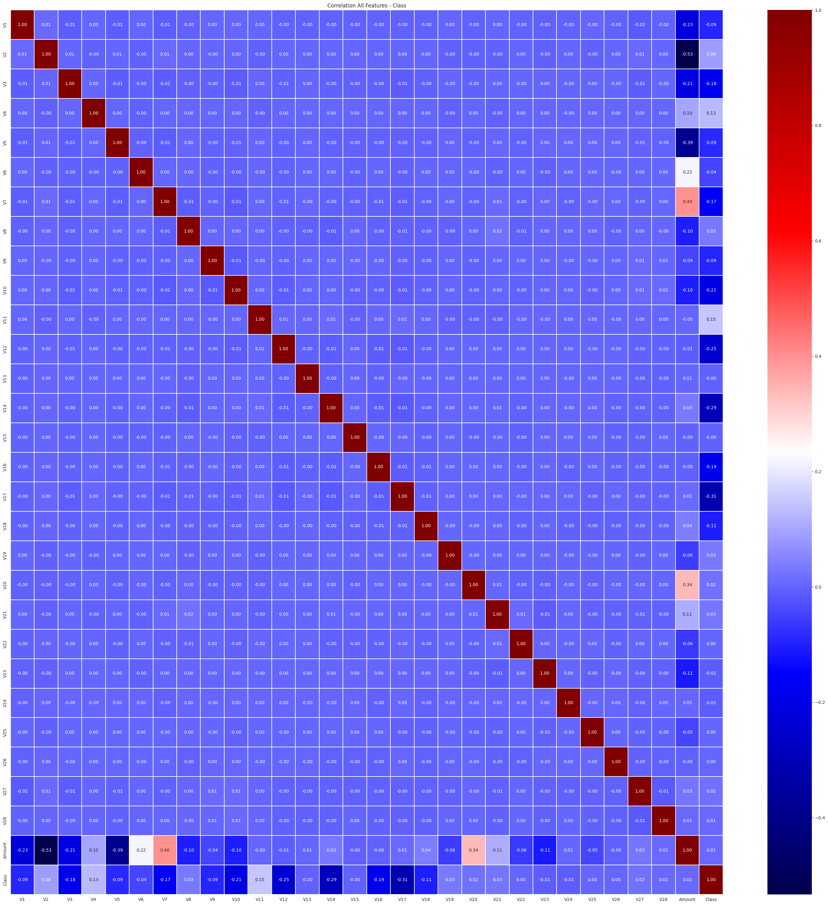
Outputs / Results
VISUALIZING the DATASET:
Correlation Matrix using Heatmap:
index,V1,V2,V3,V4,V5,V6,V7,V8,V9,V10,V11,V12,V13,V14,V15,V16,V17,V18,V19,V20 count,283726.0,283726.0,283726.0,283726.0,283726.0,283726.0,283726.0,283726.0,283726.0,283726.0,283726.0,283726.0,283726.0,283726.0,283726.0,283726.0,283726.0,283726.0,283726.0,283726.0 mean,0.005917149836165761,-0.0041347556281216905,0.0016131193558786181,-0.0029663077203488635,0.0018275601130338598,-0.001139488189738493,0.0018006917653071734,-0.0008544525734540372,-0.0015961996217021513,-0.0014407104850314848,0.00020175763995932604,-0.000714787657406006,0.0006033757913236802,0.0002523173005216223,0.0010428380498146601,0.0011620128156736782,0.00017016094454838166,0.0015151660104586549,-0.00026426358751910735,0.00018717524731653025 std,1.948026141625471,1.6467029642463507,1.5086819162059164,1.4141840144475144,1.3770082792800886,1.331930591715164,1.2276638954422558,1.1790544275788069,1.0954924810736155,1.0764073501381102,1.0187201526753205,0.9946744452140553,0.9954296367703039,0.9522150900331083,0.914893633452561,0.8736963275712339,0.8425073207466596,0.8373775297813794,0.8133785531048033,0.7699842414107975 min,-56.407509631329,-72.7157275629303,-48.3255893623954,-5.68317119816995,-113.743306711146,-26.1605059358433,-43.5572415712451,-73.2167184552674,-13.4340663182301,-24.5882624372475,-4.79747346479757,-18.6837146333443,-5.79188120632084,-19.2143254902614,-4.49894467676621,-14.1298545174931,-25.1627993693248,-9.49874592104677,-7.21352743017759,-54.497720494566 25%,-0.9159513307412135,-0.6003205657226367,-0.8896820047070662,-0.8501344664392158,-0.6898297299310185,-0.7690307688926414,-0.5525094418610073,-0.20882847161887025,-0.6442207694753568,-0.5355781093043295,-0.761649296487023,-0.4061977332430922,-0.6478620791041647,-0.425732465586286,-0.5814518450583814,-0.46685961570977524,-0.483927580381912,-0.4980142985297348,-0.4562889162254948,-0.2114692754611365 50%,0.020384054673383903,0.0639491720686272,0.1799627277579035,-0.0222480167048314,-0.05346760692155525,-0.2751676384634605,0.040859470599398345,0.021897947014776098,-0.0525956513955632,-0.09323652620247,-0.03230594037210535,0.13907201031481248,-0.012926990224900549,0.05020867775725035,0.04929885180469505,0.0671191378908382,-0.0658669329326605,-0.00214175617719485,0.0033670829391581,-0.062353459380288 75%,1.31606775368132,0.8002828928387605,1.0269599742860676,0.739646964483283,0.6122179627567953,0.39679214047379624,0.5704738684867068,0.3257036839267247,0.5959768591827228,0.4536187284492523,0.7395791921050707,0.6169764893919558,0.6631783137505225,0.492335540901136,0.6501041163940502,0.5235115807729338,0.3989717123472575,0.5019556651381313,0.4585079337186285,0.133207117892697 max,2.45492999121121,22.0577289904909,9.38255843282114,16.8753440335975,34.8016658766686,73.3016255459646,120.589493945238,20.0072083651213,15.5949946071278,23.7451361206545,12.0189131816199,7.8483920756446,7.12688295859376,10.5267660517847,8.87774159774277,17.3151115176278,9.25352625047285,5.04106918541184,5.59197142733558,39.4209042482199

Slide 7
Point Biserial Corr. and p-value

Slide 8
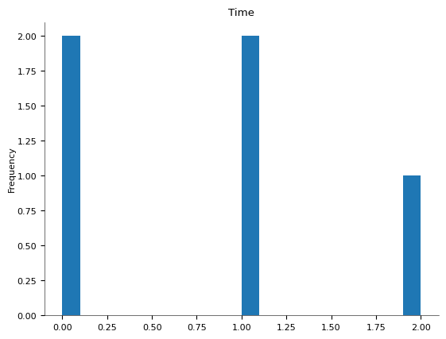
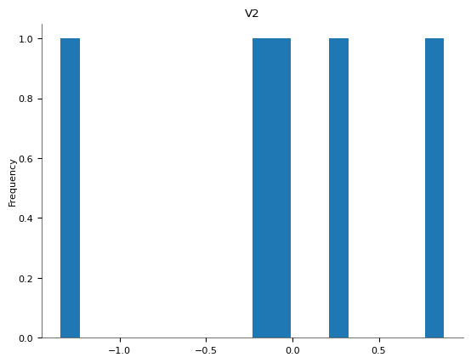

Slide 9
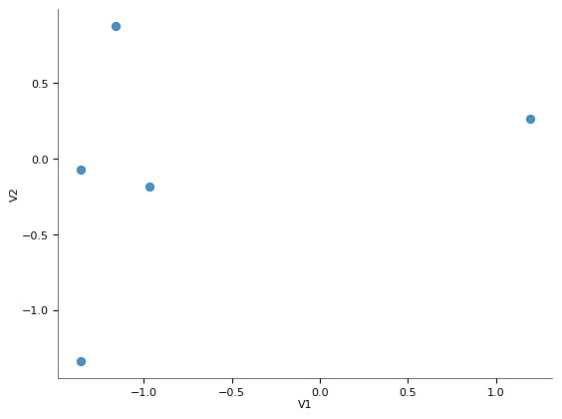
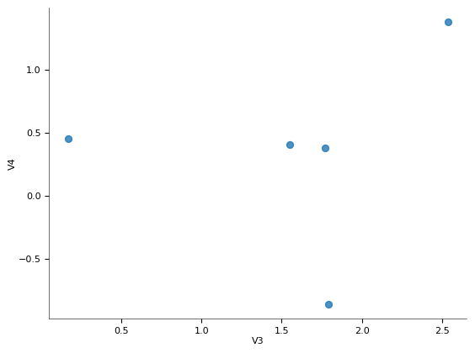

Slide 10
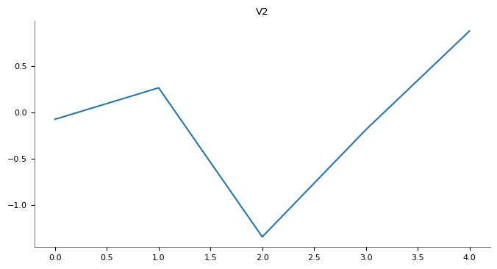
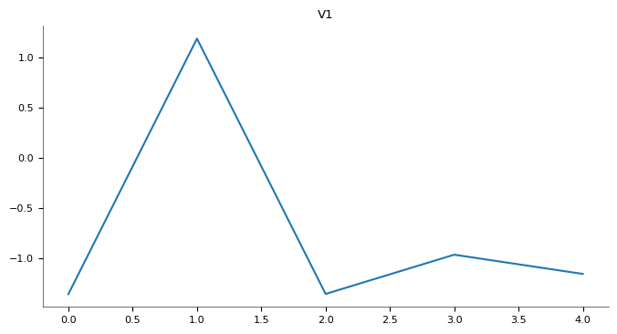

Slide 11
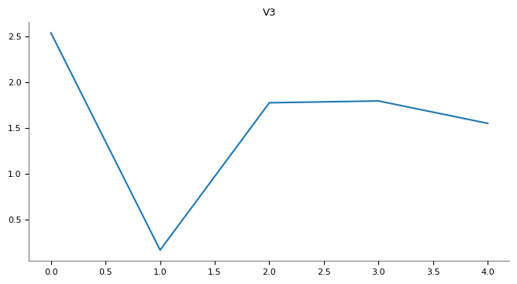
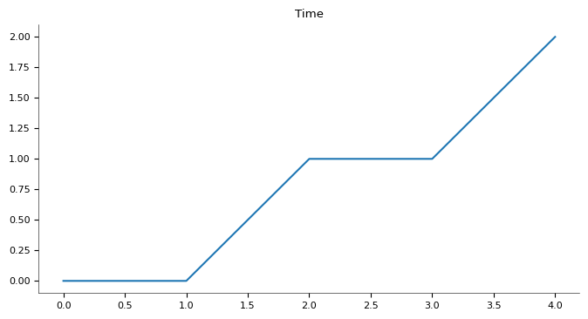

Slide 12
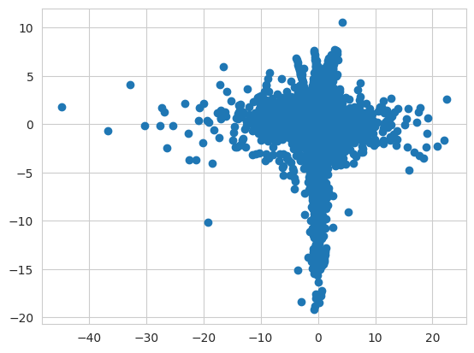
Scatter Plot: V23 vs V14

Slide 13
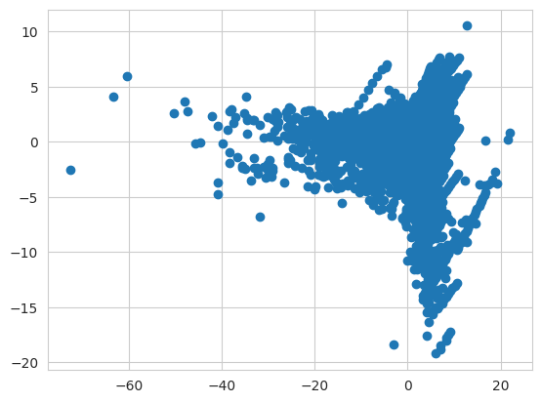
Scatter Plot: V2 vs V14

Slide 14
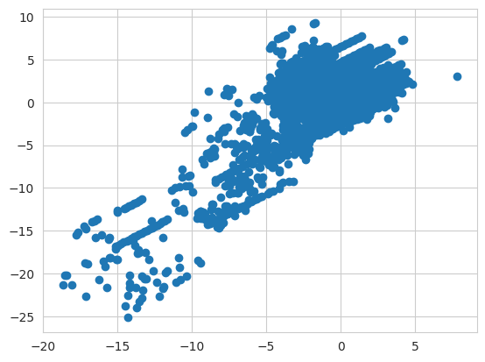
Scatter Plot : V12 vs V17

Slide 15
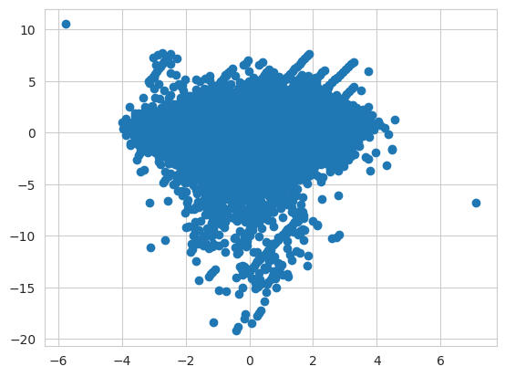
Scatter Plot : V13 vs V14

Slide 16
Summary Stat: V1 to V15

Slide 17
Summary Stat: V16 to Amount

Slide 18
Code
Code for loading the dataset:
import pandas as pd
data = pd.read_csv('/content/drive/MyDrive/Colab Notebooks/Python practice/creditcard.csv')

Slide 19
Code for standardizing the “Amount” column
from sklearn.preprocessing import StandardScaler # For normalizing the values of the Amount attribute
sc = StandardScaler()
data1["Amount"] = sc.fit_transform(pd.DataFrame(data1["Amount"]))

Slide 20
data1.duplicated().any() #checking for duplicate rows
True
data1.shape #checking the shape before dropping duplicates
(284807,31)
data1 = data1.drop_duplicates() #dropping duplicates
data1.shape #shape after removing duplicates
(283726,31)

Slide 21
Code for checking no of Fraud Cases from the “Class” attribute
fraud = data1[data1['Class'] == 1]
valid = data1[data1['Class'] == 0]
outlierFraction = len(fraud)/float(len(valid))
print(f'{outlierFraction*100}%')
print('Fraud Cases: {}'.format(len(fraud)))
print('Valid Transactions: {}'.format(len(valid)))

Slide 22
Removing unnecessary columns
Dropping “Time” column
data1=data1.drop(["Time"], axis = 1)
data1.describe()- for summary statistics
Since clustering is an unsupervised algorithm the column “Class” which is the Target variable given in the Dataset is unnecessary and hence dropped
Point Biserial Corr. and p-value analysis shows that V15 and V25 have p-value > 0.05 so we can drop them for better results
x = data1.drop(columns =['Class',’V15’,’V25’,axis=1)

Slide 23
Code for visualizing the correlation matrix
import matplotlib.pyplot as plt
import seaborn as sns
sns.set_style("whitegrid")
corr = data1.corr()
plt.figure(figsize= (37,37))
sns.heatmap(corr, annot=True, cmap='seismic',fmt=".2f",linewidths = 0.1)
plt.title("Correlation All Features - Class")

Slide 24
Code for the scatter plots
plt.scatter(x.V12,x.V17)
plt.scatter(x.V23,x.V14)
plt.scatter(x.V2,x.V14)
plt.scatter(x.V13,x.V14)
plt.show()

Slide 25
Importing necessary modules for clustering
from sklearn.cluster import Kmeans
from sklearn.cluster import DBSCAN
scaler = StandardScaler()
scaled_features = scaler.fit_transform(x)
from sklearn.metrics import silhouette_score

Slide 26
DBSCAN, K-Means , Silhouette Score
dbscan = DBSCAN(eps=0.3)
dbscan.fit(scaled_features)
dbscan_silhouette = silhouette_score(scaled_features, dbscan.labels_).round (2)
kmeans = KMeans(n_clusters = 2, init = 'k-means++', max_iter = 300, n_init = 10, random_state = 0)
kmeans.fit(x)
kmeans_silhouette = silhouette_score(scaled_features, kmeans.labels_).round(2)
kmeans_silhouette

Slide 27
Accuracy of the model and scope of
Improvement
Silhouette score for K-Means – 0.05 (NOT good)
Silhouette score for DBSCAN - -0.42 (NOT good)
The model can be improved by altering the metric parameter from Euclidean to Manhattan or Cosine some improvement can be achieved .
For a dataset of 283726 data points and 30 features , the system requires sufficient memory and computational resources to handle the clustering process efficiently, especially if you're using distance-based methods like KMeans or DBSCAN.

Slide 28
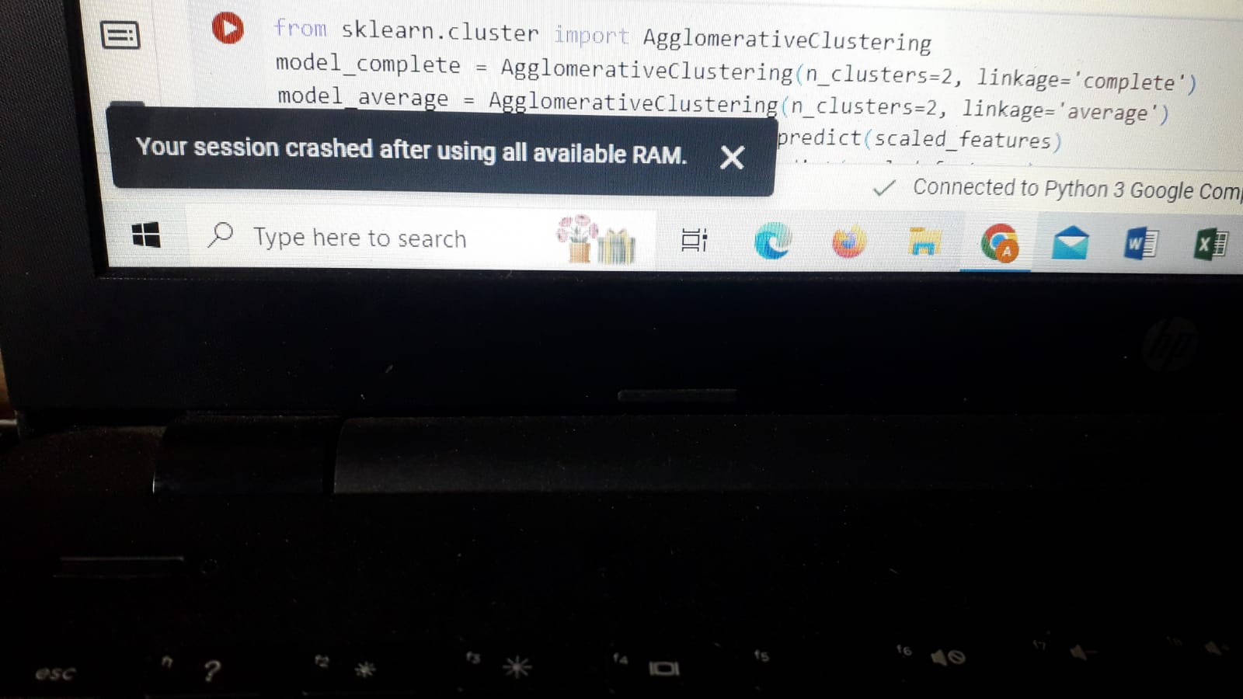
Your Learnings from this Project
This dataset is quite complex
Time complexity for the algorithms and visualizations like ‘Boxplot’ and ‘Violin Plot’ was very high about 30 – 45 min and didn’t compile sometimes showing error statement ‘MemoryError: Unable to allocate 300. GiB for an array with shape (40250079675,) and data type float64’.

Slide 29
I got an experience of dealing with such a complex dataset
Learnt about Point Biserial Correlation and p-value analysis

Slide 30
Thank You

